Slide 1
Chapter 16 – Cartilage and Bone Regeneration

Slide 2
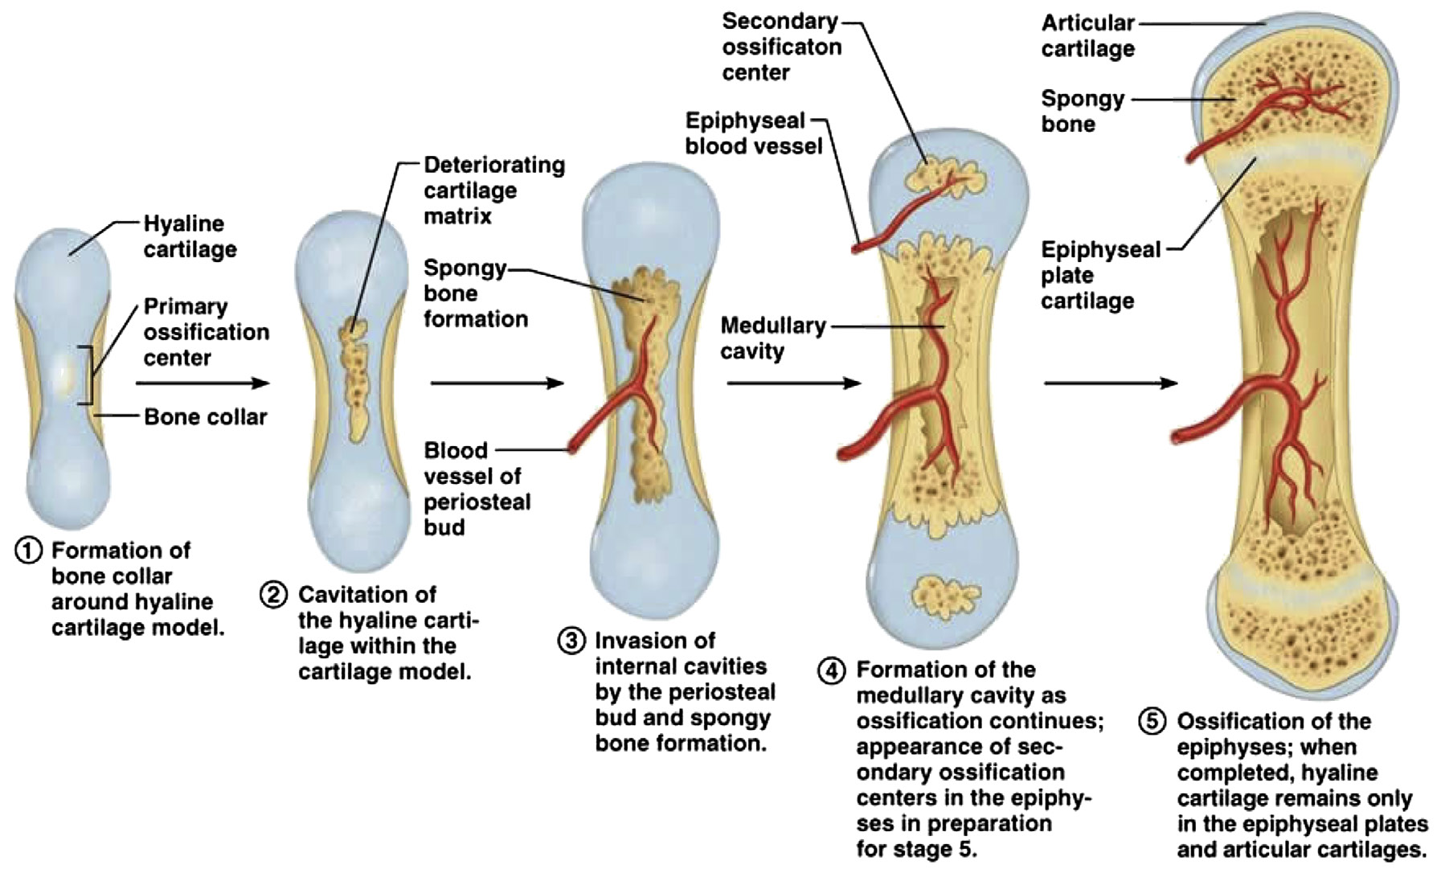
Notes:
Figure 16.1: Cartilage and bone formation.

Slide 3
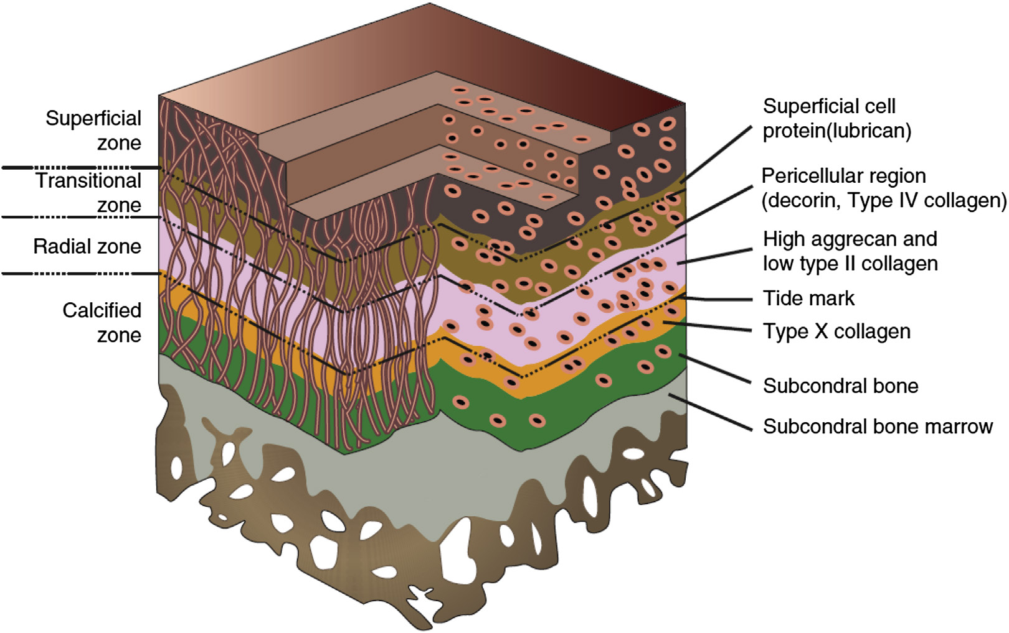
Notes:
Figure 16.2: Structural and functional zones of articular cartilage.
Adapted from Composition and structure of articular cartilage: a template for tissue repair, Poole et al., 2001, Clin. Orthop. S26–S33.

Slide 4
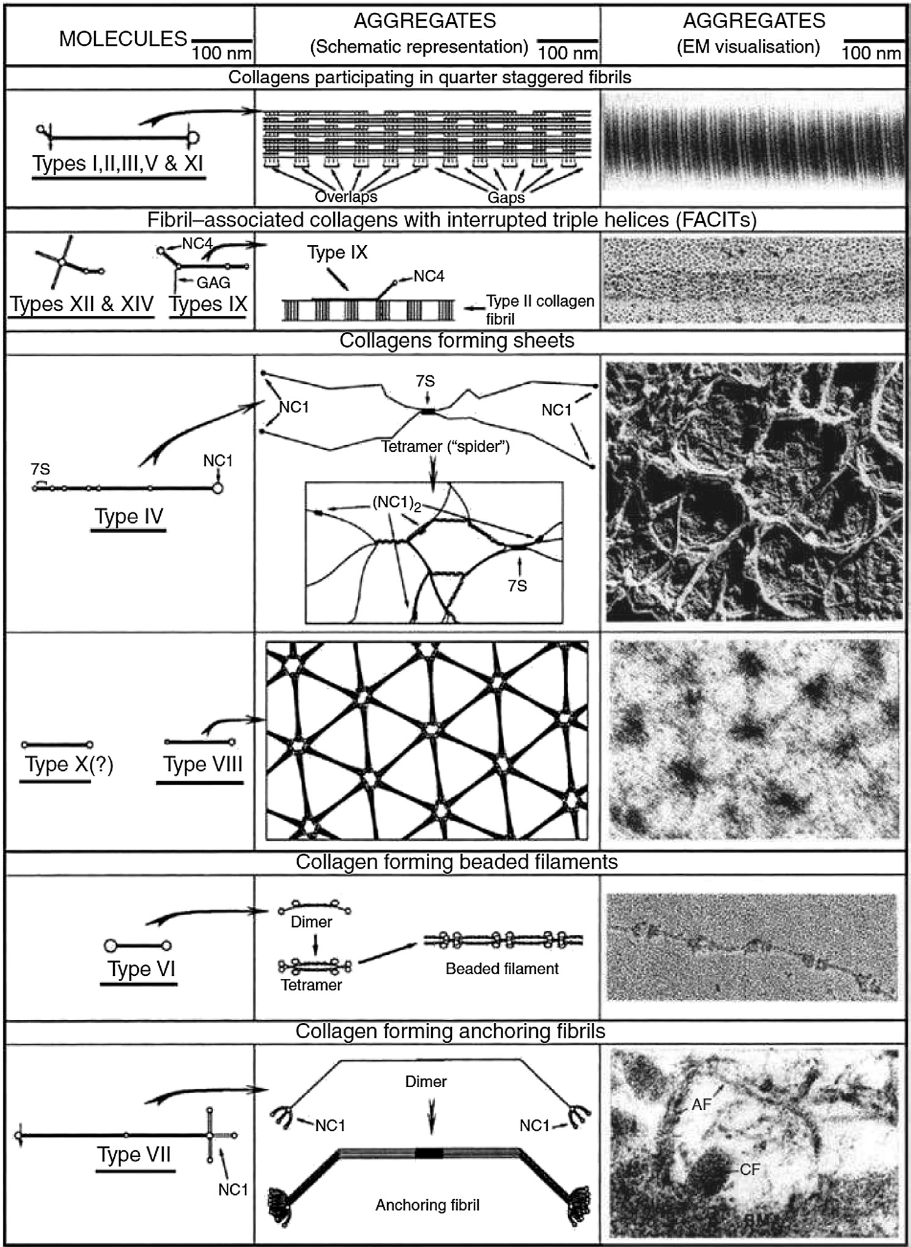
Notes:
Figure 16.3: Molecular structure and supramolecular assemblies of collagens.
From Collagen family of proteins, Van Der Rest and Garrone, 1991, FASEB J. 5, 2814–2823.

Slide 5
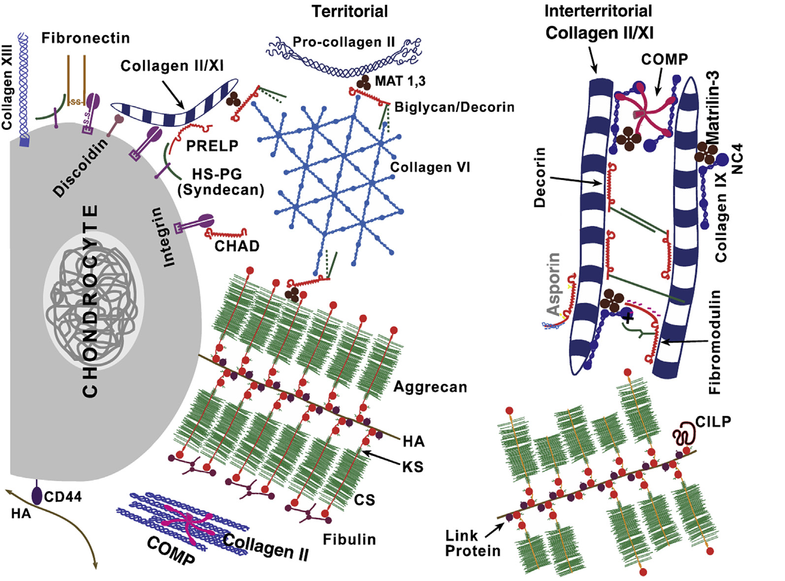
Notes:
Figure 16.4: The molecular organization of normal articular cartilage.
From The role of the cartilage matrix in osteoarthritis, Heinegard and Saxne, 2011, Nat. Rev. Rheumatol, 7, 50–56.

Slide 6
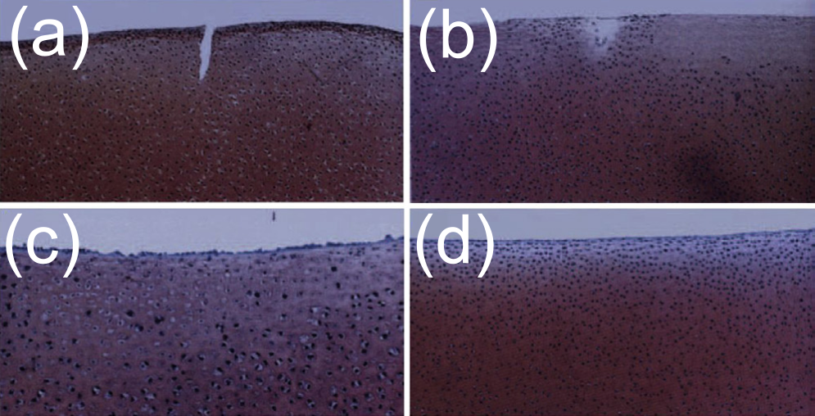
Notes:
Figure 16.5: Spontaneous repair of superficial defects in articular cartilage in a fetal lamb model.
From Spontaneous repair of superficial defects in articular cartilage in a fetal lamb model, Namba et al., 1998, J. Bone Jt. Surg. Am. 80, 4–10.

Slide 7
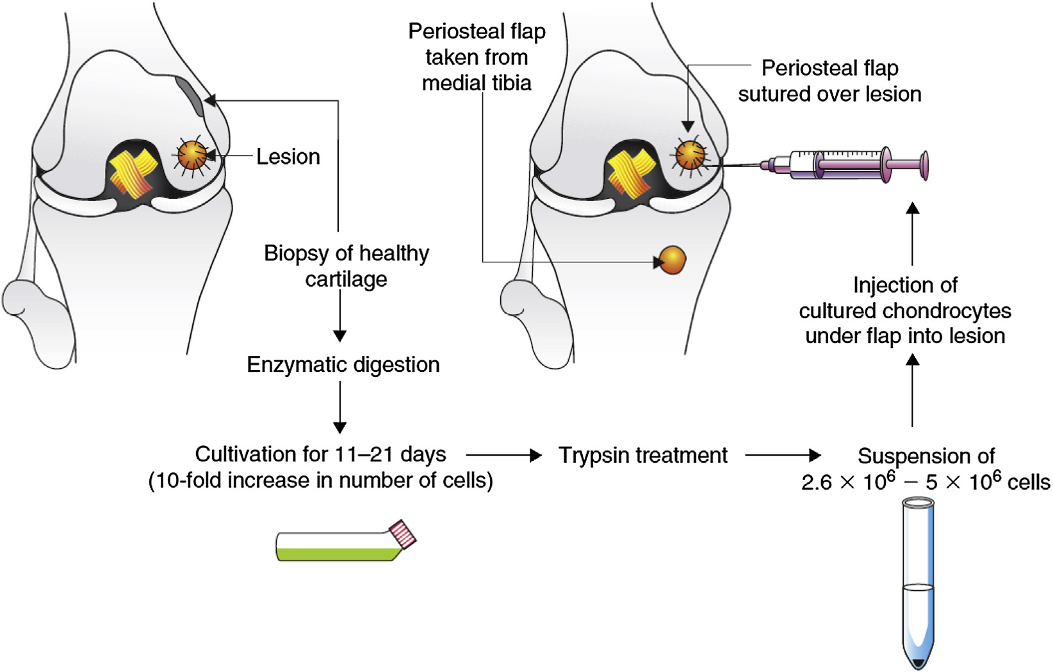
Notes:
Figure 16.6: Autologous chondrocyte transplantation procedure.

Slide 8
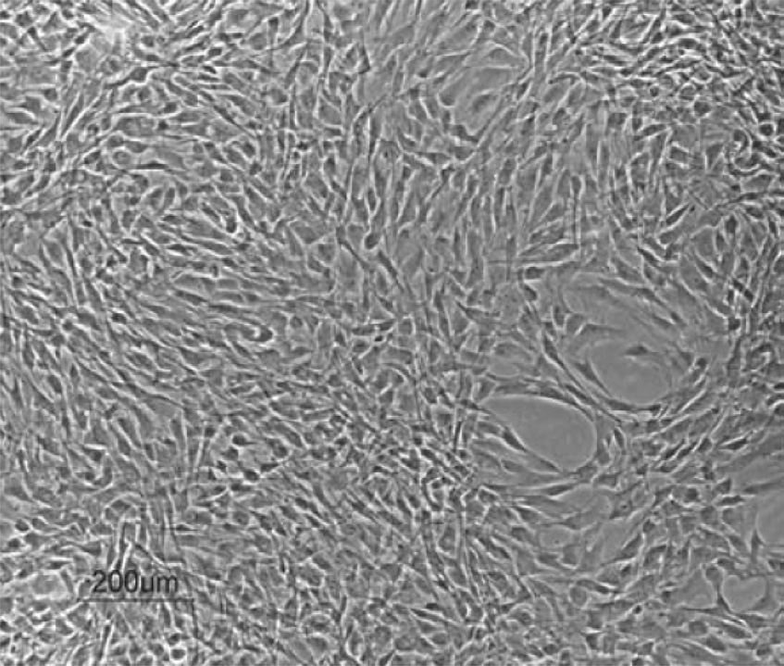
Notes:
Figure 16.7: Human articular chondrocytes in monolayer cultures prior to implantation in the autologous chondrocyte transplantation procedure.

Slide 9
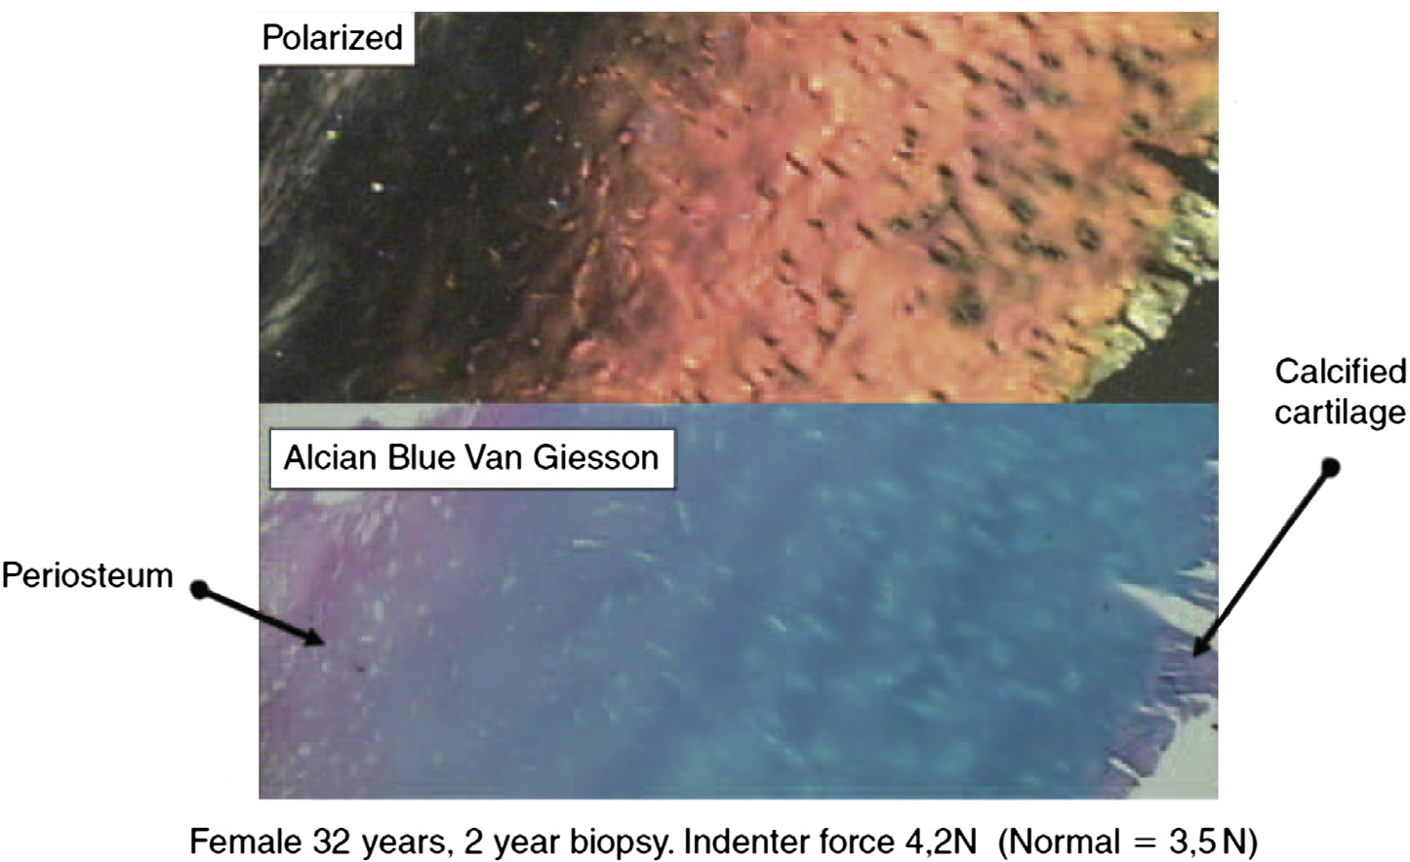
Notes:
Figure 16.8: Regenerated cartilage from the autologous chondrocyte transplantation procedure 2 years after cell implantation.

Slide 10
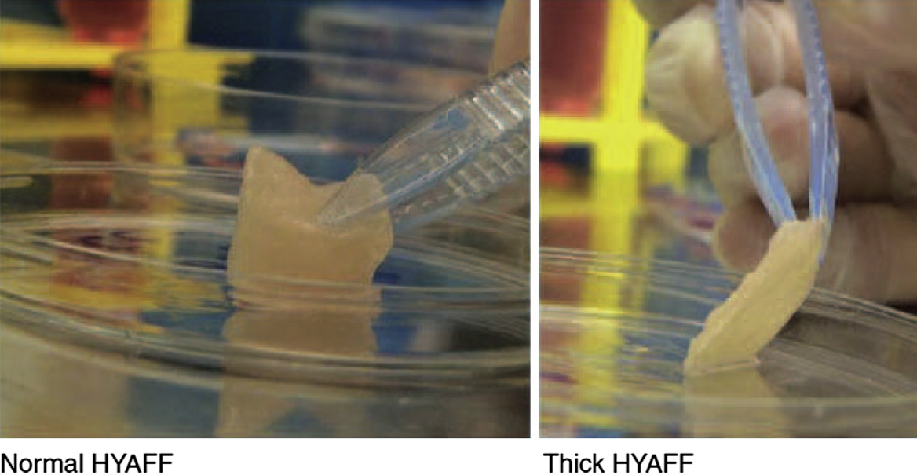
Notes:
Figure 16.9: Cartilage graft construct based on chondrocytes cultured in hyaluronic acid.

Slide 11
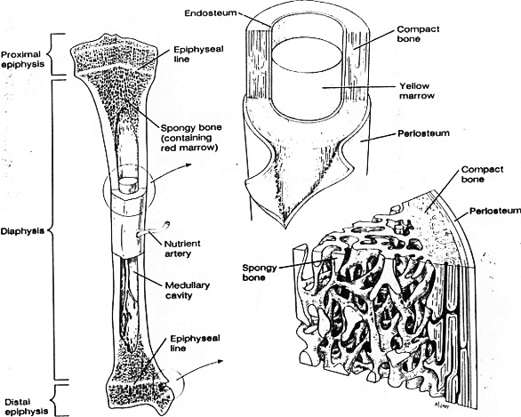
Notes:
Figure 16.10: Diagram of the structure of a long bone.
From Basic Human Anatomy, third ed., Spence, A., 1991, Addison-Wesley, Redwood City, CA.

Slide 12
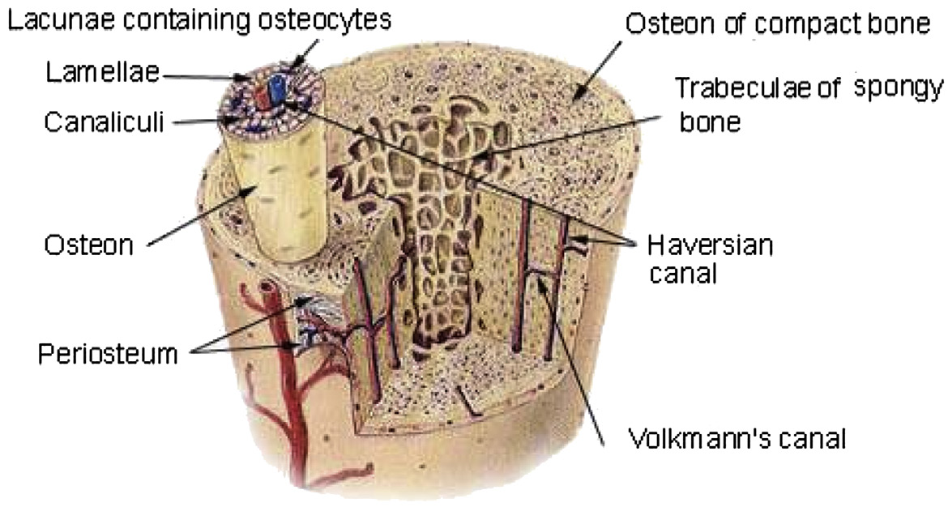
Notes:
Figure 16.11: The microstructure of bone.
From The Human Bone Manual, White and Folkens, 2005, Academic Press.

Slide 13
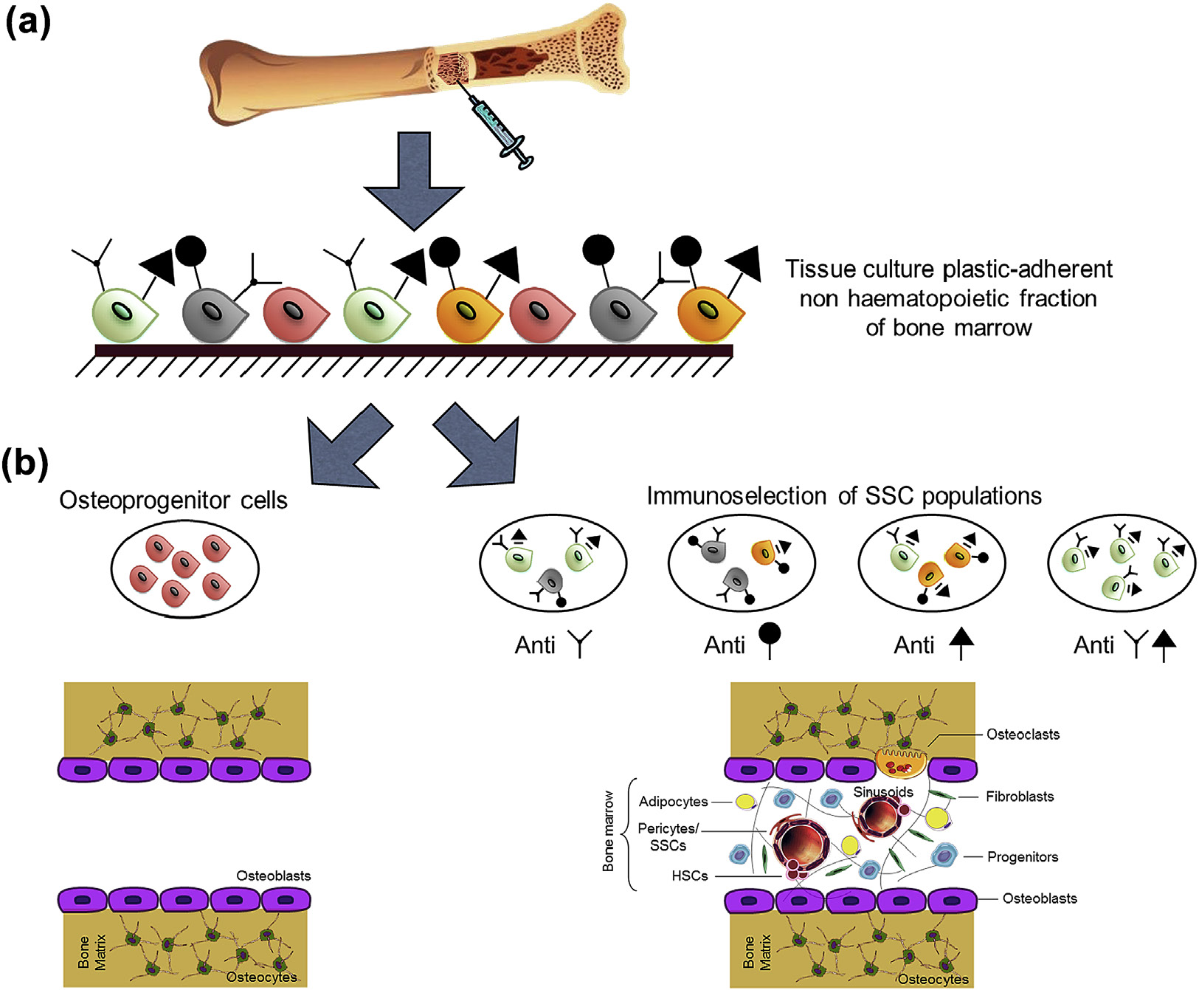
Notes:
Figure 16.12: SSCs establish, organize, and transfer the hematopoietic niche in vivo.
From Concise review: bridging the gap: bone regeneration using skeletal stem cell‐based strategies—where are we now? Dawson et al., 2014, Stem Cells 32, 35–44.

Slide 14
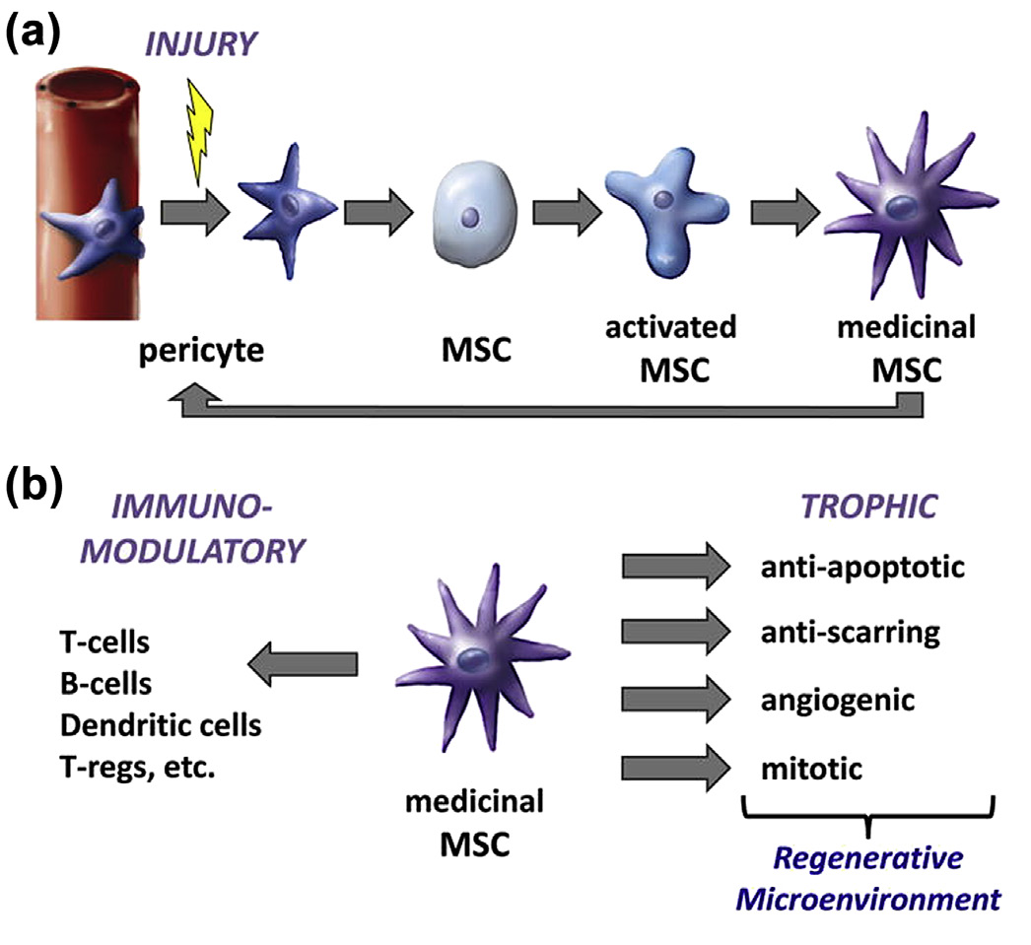
Notes:
Figure 16.13: MSCs are immunomodulatory and trophic.
From The MSC: an injury drugstore, Caplan and Correa, 2011, Cell. Stem Cell 9, 11–15.

Slide 15
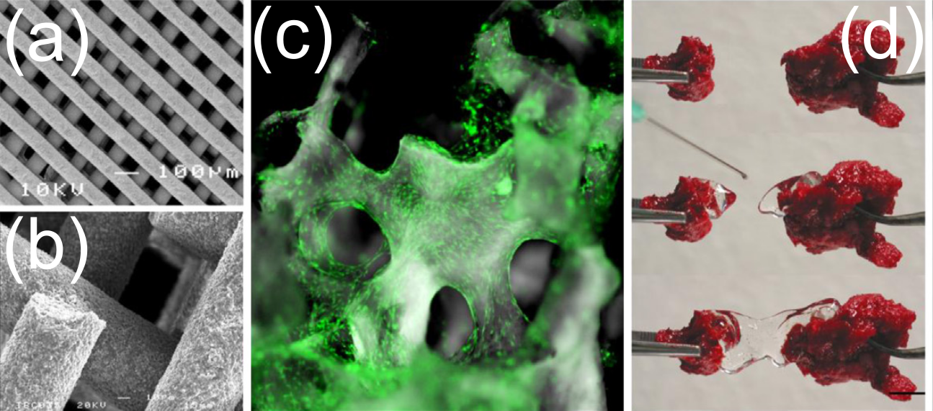
Notes:
Figure 16.14: Ways to form scaffolds.

Slide 16
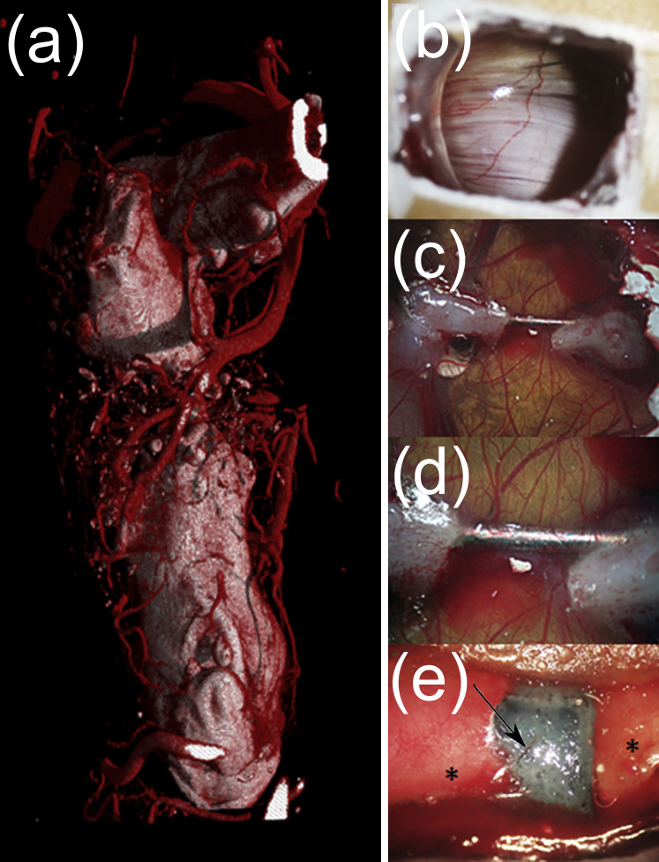
Notes:
Figure 16.15: The three-dimensional image (μCT) of perfused contrast vascular dye (red) depicting the blood vessels in a critical sized mouse femur defect (a). The window of a D18 chick egg depicting the vasculature of the CAM (b). D18 chick femur defect stabilized with a 26 G needle after 8 days of implantation in the CAM: c) low magnification, d) high magnification. D18 chick demur defect with an implanted bioscaffold in the defect region (e) (arrow = blood vessel; ∗ = bone) after 8 days of implantation in the CAM.

Slide 17
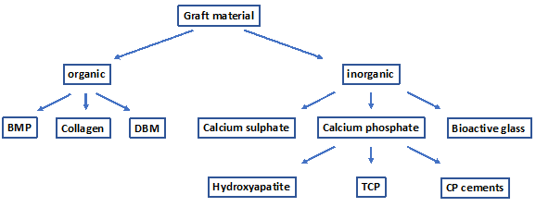
Notes:
Figure 16.16: Examples of different organic and inorganic graft materials.

Slide 18
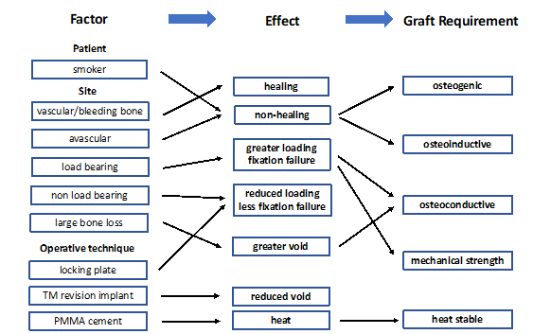
Notes:
Figure 16.17: Matrix that indicates how patient and surgical requirements determine the graft’s biological response.

Slide 19
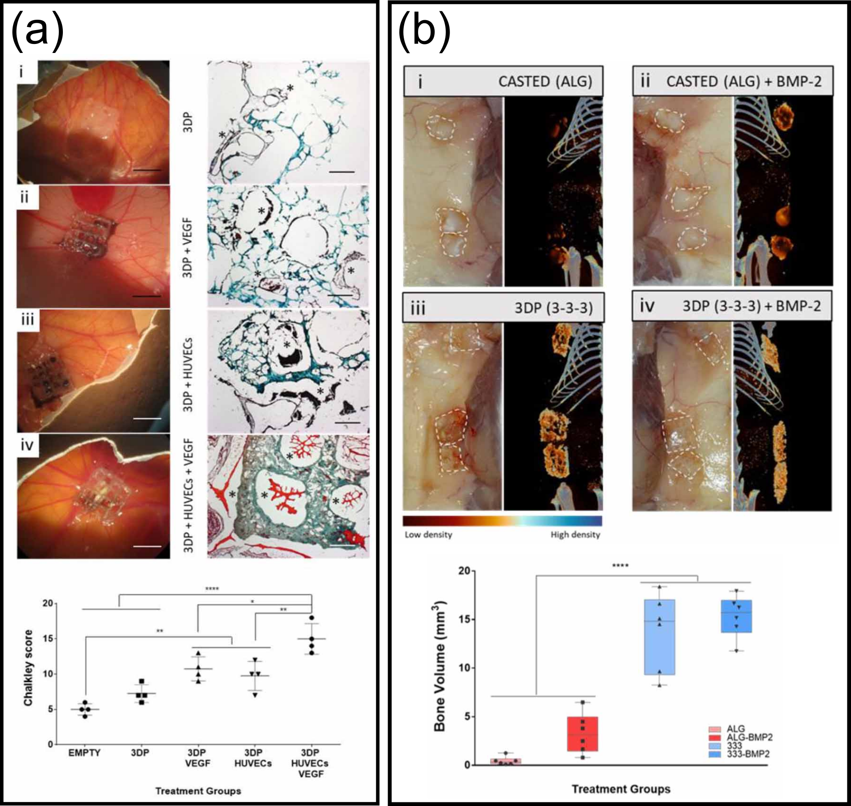
Notes:
Figure 16.18: a) Vascularization in a chick chorioallantoic membrane assay observed in 3DP (3,3,3) scaffold alone and with: VEGF, HUVEC, and both VEGF & HUVEC. b) Bone formation on 3DP(3,3,3) scaffold alone and in combination with BMP in a subcutaneous murine model with alginate control.
From Nanoclay-based 3D printed scaffolds promote vascular ingrowth ex vivo and generate bone mineral tissue in vitro and in vivo, Cidonio et al.. Biofabrication. 2020 May 12;12(3):035010. doi: 10.1088/1758-5090/ab8753.

